Slide 1
py.test

Slide 2
Example
from unnecessary_math import multiply
def test_numbers_3_4():
assert multiply(3,4) == 12
def test_strings_a_3():
assert multiply('a',3) == 'aaa'

Slide 3
How to run cases?
python -m pytest test_um_pytest.py
py.test test_um_pytest.py

Slide 4
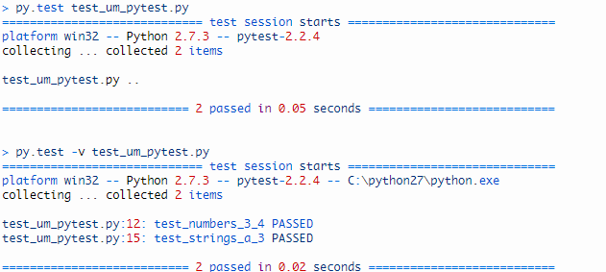
Result

Slide 5
Assertions
assert expr
assert a == b
self.assertEqual(a, b)
assert expr, “Expected message”

Slide 6
Assertion example
Define Own Comparison
# content of conftest.py
def pytest_assertrepr_compare(op, left, right):
if (isinstance(left, Foo) and isinstance(right, Foo) and op == "=="):
return ['Comparing Foo instances:',
'vals: {0.val} != {1.val}'.format(left, right)]

Slide 7
Assertions
Define Own Comparison
def test_compare():
assert Foo(1) == Foo(2)
assert f1 == f2
assert Comparing Foo instances: vals: 1 != 2

Slide 8
Assertions
Py.test refined `assert` statement
Note: `assert expr, msg` won't output traceback

